Slide 1


A Statistical Analysis of Indian Smartphone Users
Submitted By:
Ishika Jaiswal(A22018)
Pulokesh Chatterjee(A22026)
Soumya Roy(A22034)

Slide 2
Objective
This project is an attempt to analyze Indian Smartphone users so that our research findings can be used by relevant organizations to improve their existing products and as well will help them to launch new products suited for our Indian market.

Slide 3
Data Collection
Sampling Methods
We have collected data from existing smartphone users using Google Form. Our survey recorded 286 responses.
Snowball Sampling Technique
Convenience Sampling Technique

Slide 4
About our survey form
What is your age?
From where will you like to buy a new smartphone?
Some of the questions we asked
What is the most important factor for you while buying a smartphone?
How much money are you ready to pay for your smartphone?

Slide 5
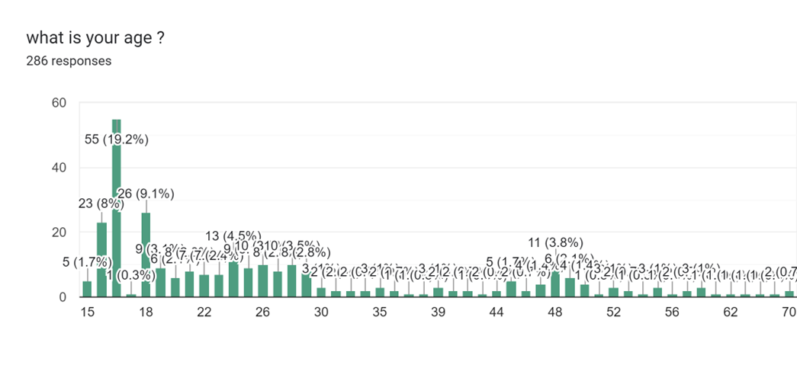
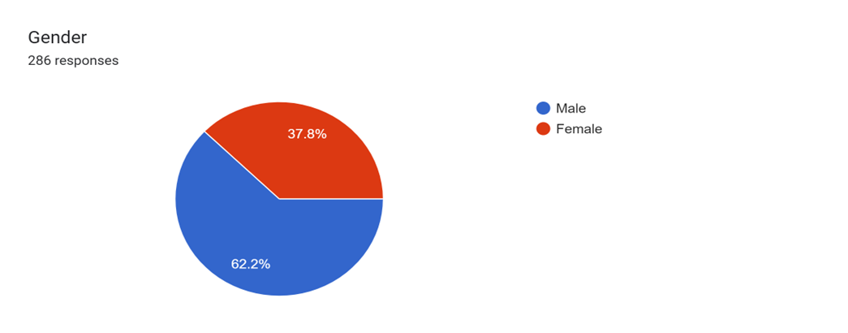
About the data collected
Most of our responders came from an age group of 15-18
Percentage of male responders is 62.2%
Percentage of female responders is 37.8%

Slide 6
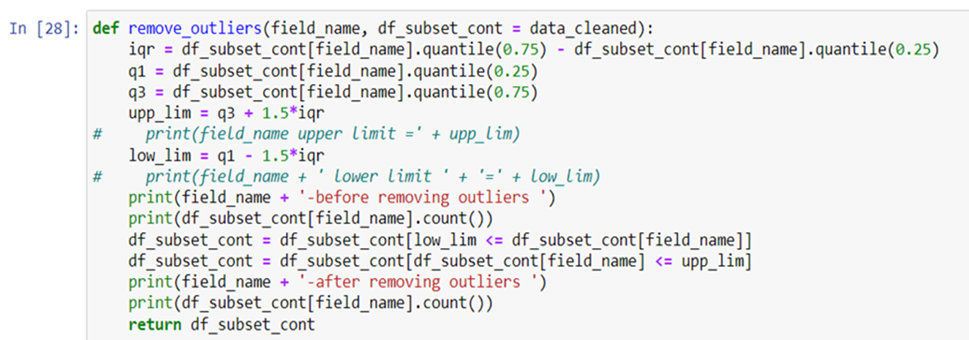

Data preprocessing
There were 20 null values in our dataset which were replaced with their respective modal value.
Outliers were removed using IQR
Cleaned data was split into two parts age<= 30 and age > 30 for further analysis.
Features | Before Removal | After removing Outliers
Age | 284 | 278
Buying Capacity | 278 | 255
Buying Cycle | 255 | 249
Final Records Left : 249

Slide 7
Age <= 30

Slide 8
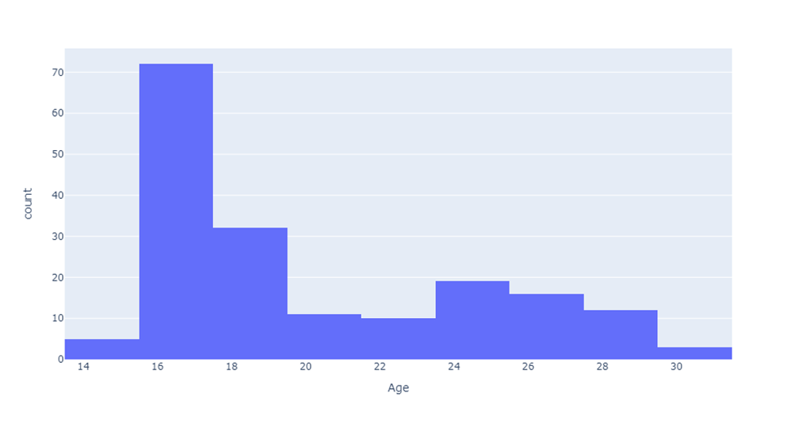
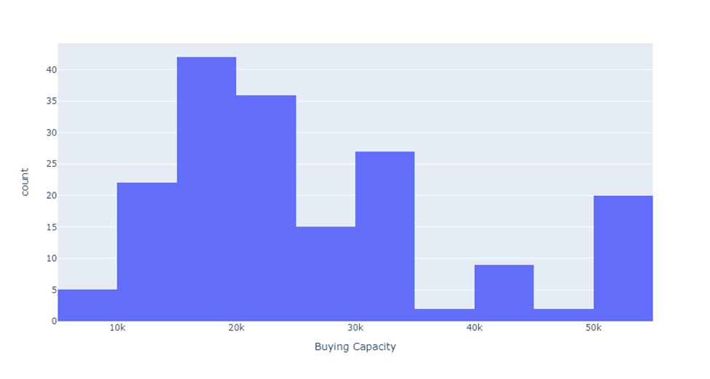
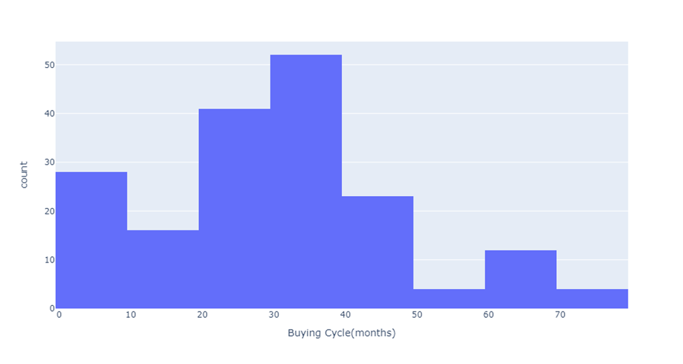
Univariate Analysis on the Continuous Variable : Graphical EDA
We have plotted some Histogram here ;
On Ages
On Buying Capacity
On Buying Cycle

Slide 9
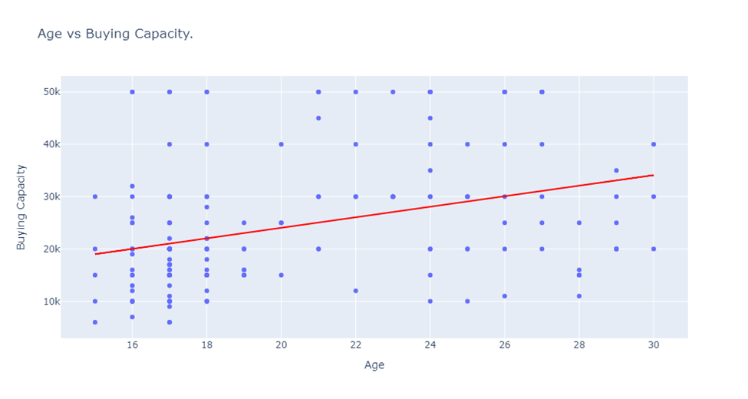
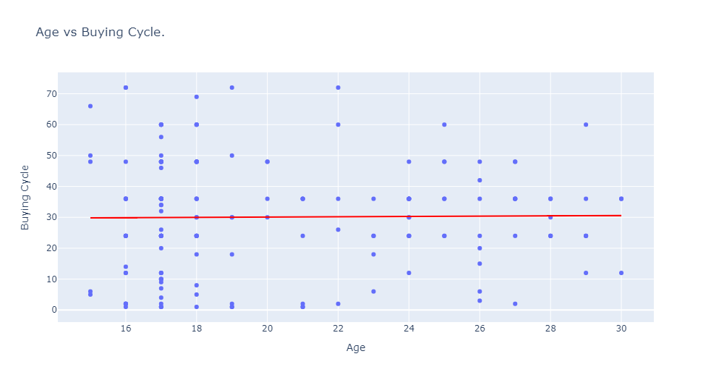
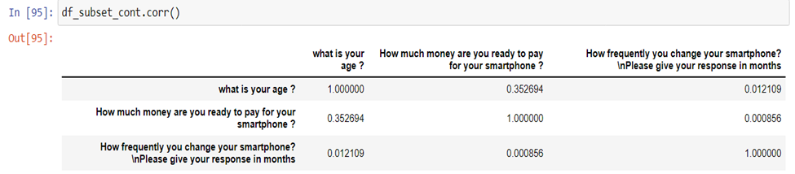
Bivariate Analysis
We plotted two scatter diagrams, one between Age and buying cycle and the other one between Age and Buying capacity. It can be concluded from the scatter diagrams and as well as from correlation values, that there are very weak linear associations between these variables.

Slide 10
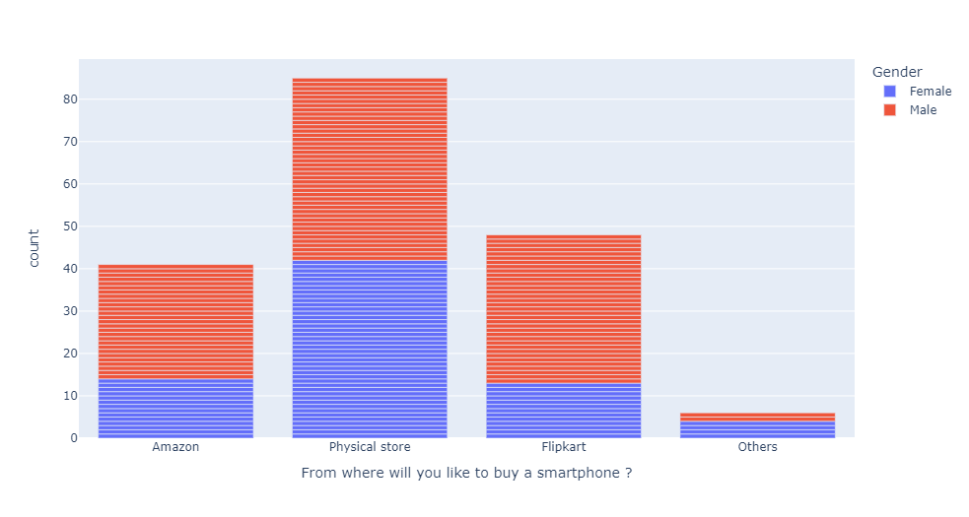
Analysis on the categorical variables
In this bar chart we have kept the preferred buying window of people on the X axis and gender is kept as legends.
Both females and males are preferring to buy from physical stores.
Physical stores > Flipkart > Amazon > Others

Slide 11
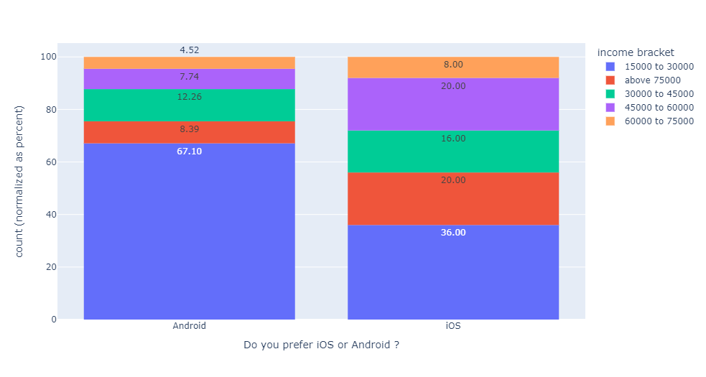
Analysis on the categorical variables
Around 67 percent of all the people who are buying android phones belong to the income bracket of 15000 to 30000
For IOS users the figures are a bit different, about 36 percent of the total IOS users fall in the income bracket of 15000 to 30000.
People belonging to this income bracket are also the highest contributor in each of these categories.

Slide 12
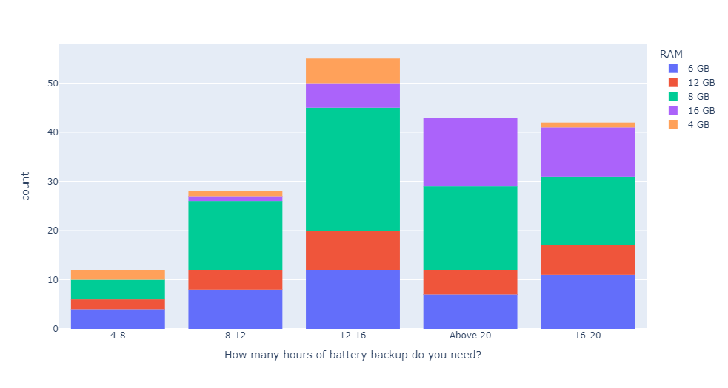
Analysis on the categorical variables
Most of the people are preferring a battery backup between 12-16 hrs.
we can also say that while buying a smartphone the combination of 12-16 hours of battery backup with a RAM of 8 GB is mostly preferred by our responders.

Slide 13
Age > 30

Slide 14
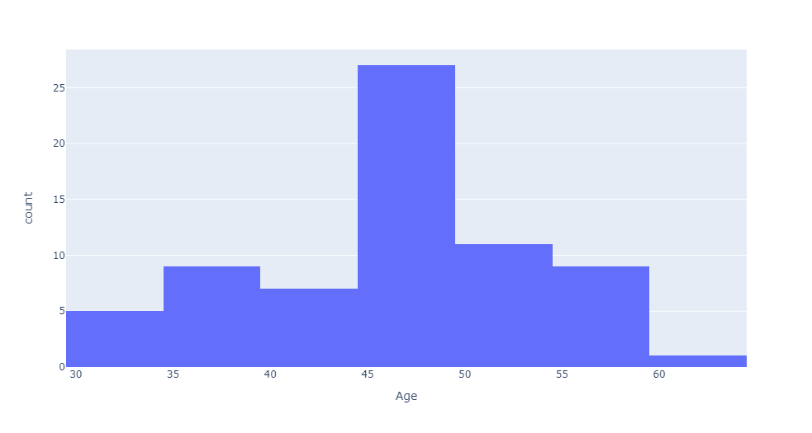
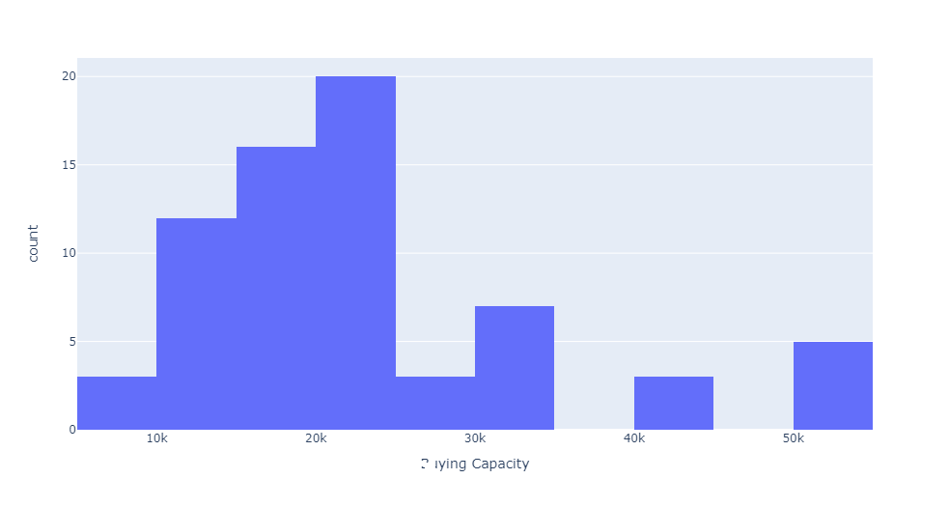
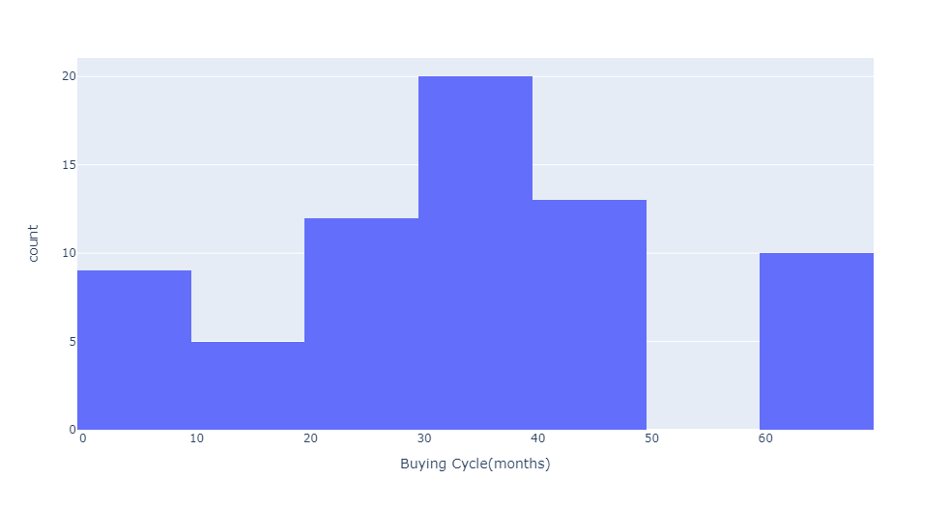

Univariate Analysis on the Continuous Variable : Graphical EDA
We have plotted some Histogram here ;
On Ages
On Buying Capacity
On Buying Cycle

Slide 15
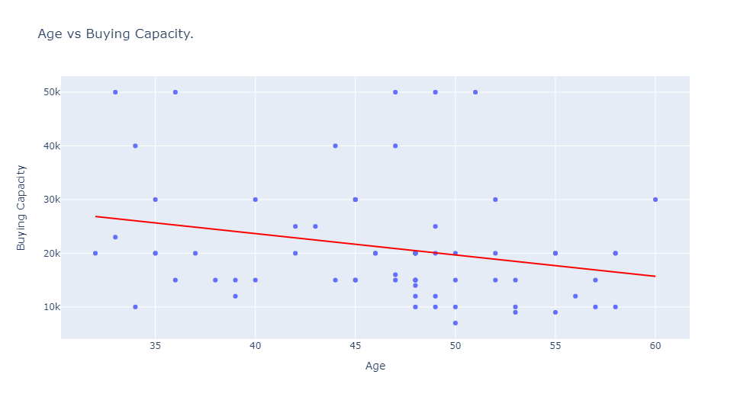
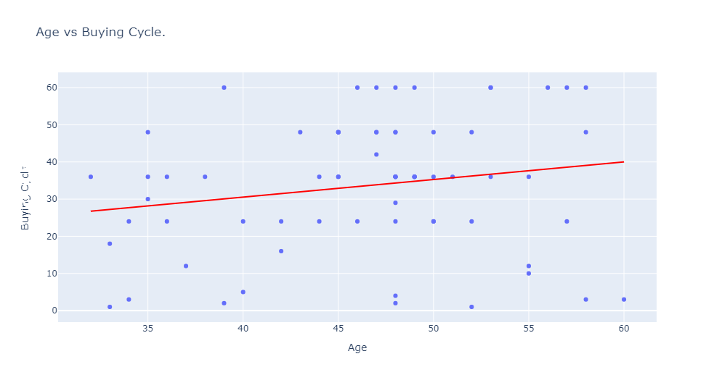
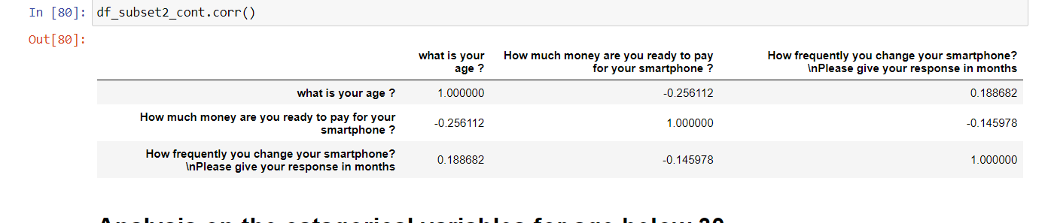
Bivariate Analysis
We plotted two scatter diagrams, one between Age and buying cycle and the other one between Age and Buying capacity. It can be concluded from the scatter diagrams and as well as from the correlation values there is very weak linear association between these variables.

Slide 16
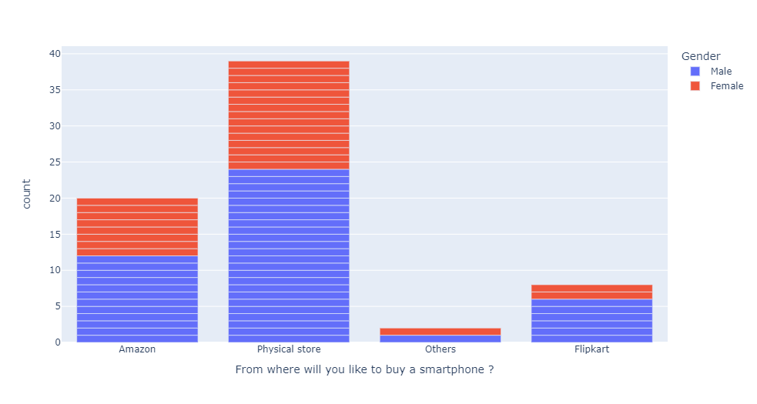
Analysis on the categorical variables
In this bar chart we have kept the preferred buying window of people on the X axis and gender is kept as legends.
Both females and males are preferring to buy from physical stores.
Physical stores > Amazon > Flipkart > Others

Slide 17
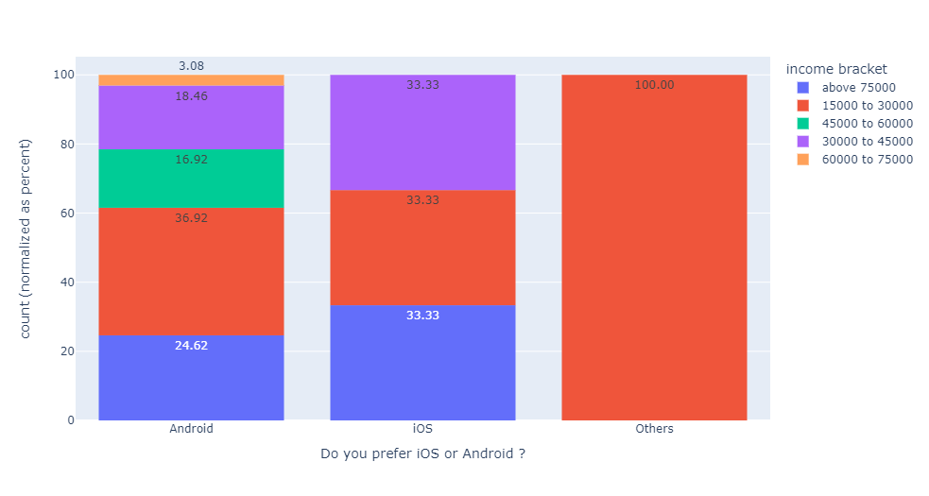
Analysis on the categorical variables
Around 36 percent of all the people who are buying android phones belong to the income bracket of 15000 to 30000
For IOS users the figures are slightly different, about 33 percent of the total IOS users fall in the income bracket of 15000 to 30000.
The IOS users in same numbers are coming from three income brackets 15000 to 30000, above 75000 and 30000 to 45000 .

Slide 18
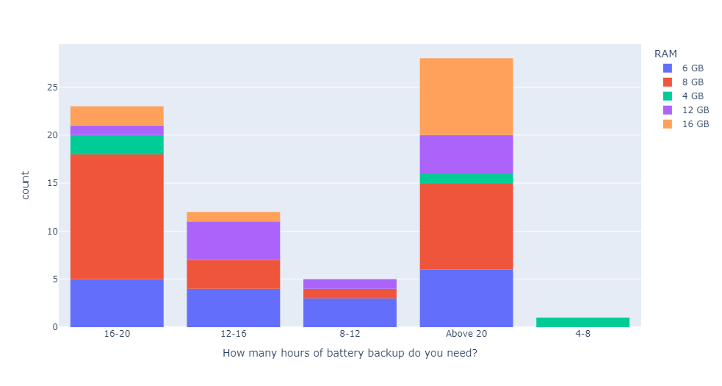

Analysis on the categorical variables
From the graph we can conclude that most of the people are preferring a battery backup of more than 20 hours.
If we arrange the preference of battery backup in a descending order, then we will get it as follows:
Above 20 > 16-20> 12-16> 8-12> 4-8
preferred combinations:
Above 20 hours and 8GB of ram
16-20 hours of battery back up and 8 GB ram
12-16 hours of battery backup and 12 gab rams.

Slide 19
Age<=30 U Age>30

Slide 20
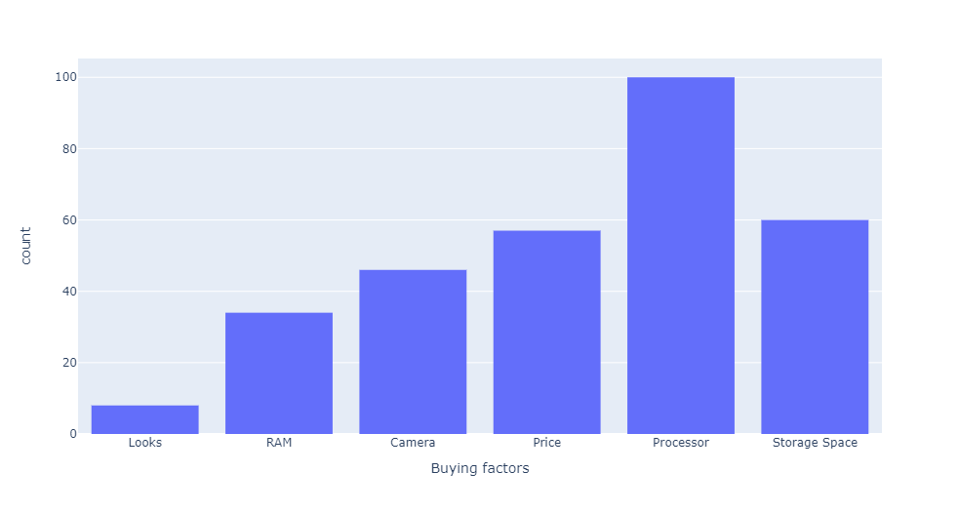
Buying factors
We can see that processor stands out to be the most important factor for buying a smartphone. If we arrange the buying factors in descending order the order will be as follows:
Processor > Storage space > Price> Camera> RAM> Looks

Slide 21
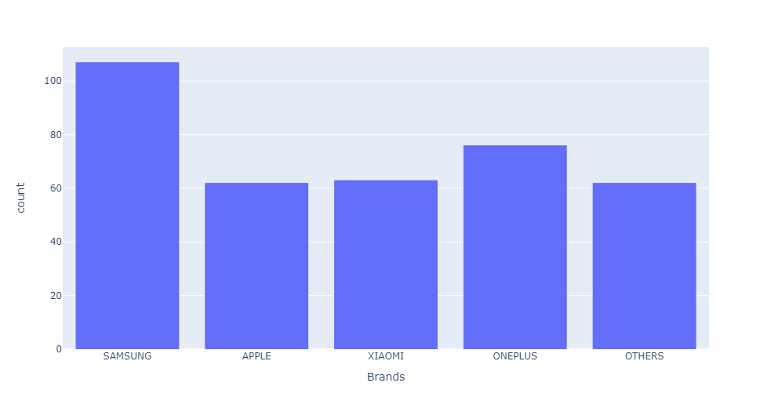
Brands
SAMSUNG stands out be the most preferred brand. If we arrange the brand preferences in a descending order the order will be as follows:
SAMSUNG > ONEPLUS > XIAOMI > APPLE = OTHERS

Slide 22
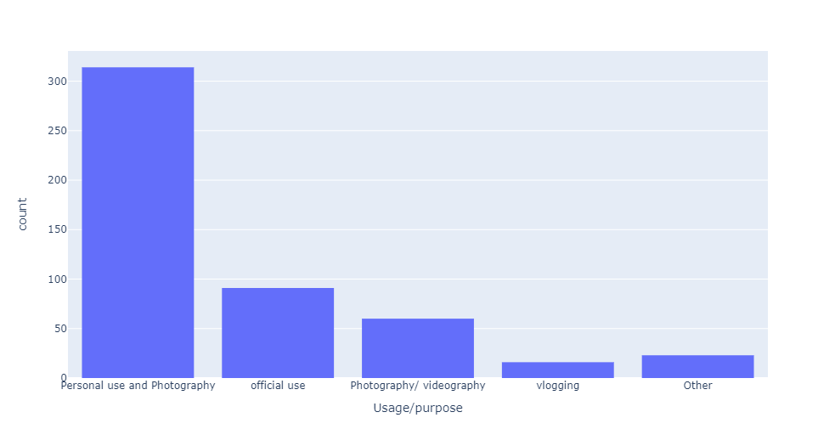
Usage/Purpose
Personal use and Photography come out to be the most important purpose for buying a smartphone.

Slide 23
THANK YOU

